Slide 1
Term Project:
Analysis of Covid-19 Data
黃國豪 109598074
陳廷豪 110598040

Slide 2
Outline
Introduce
Data Set
Method
Result
Conclusion
Reference

Slide 3
Introduction
Use Pyspark、Spark、Hadoop、Jupyter Notebook
We would like to analyse the COVID-19 data for cases, deaths and vaccinated
Use the latest data set of the world

Slide 4
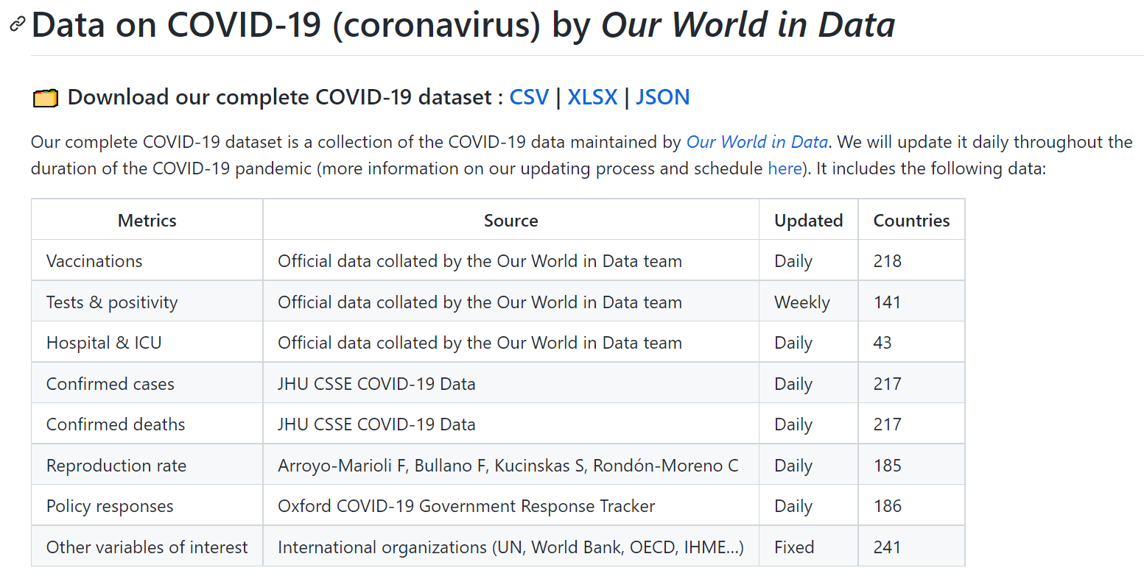
Data Set
Data set: owid/owid-datasets: OWID Dataset Collection (github.com)

Slide 5
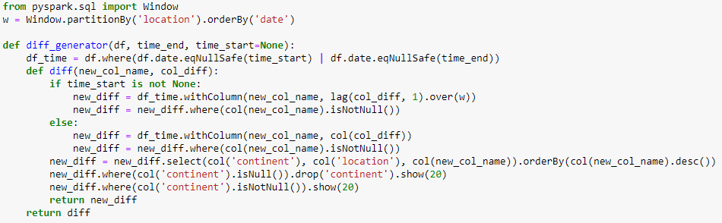
Method

Slide 6
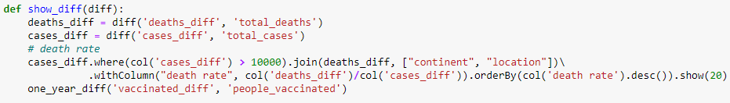

Method

Slide 7
Result

Slide 8
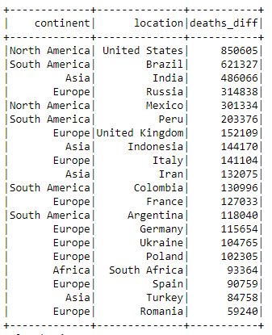
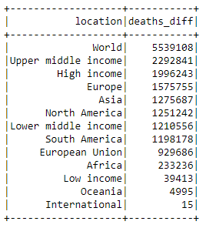
Number of deaths NOW

Slide 9
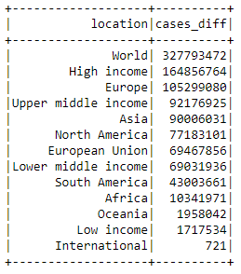
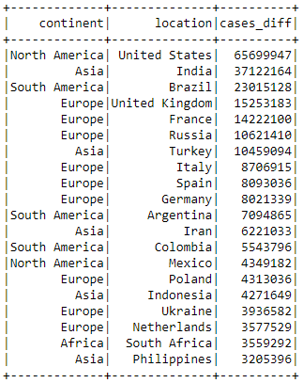
Number of cases NOW

Slide 10
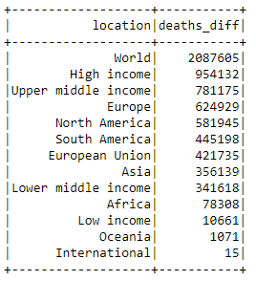
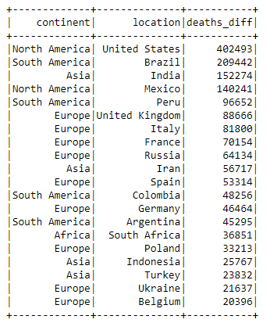
Number of deaths in one year (2021/01/16 ~ 2022/01/16)

Slide 11
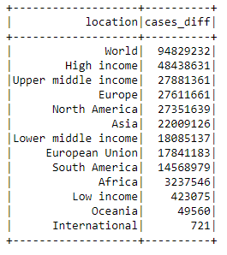
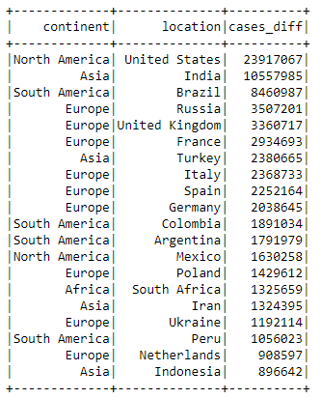
Number of cases in one year

Slide 12
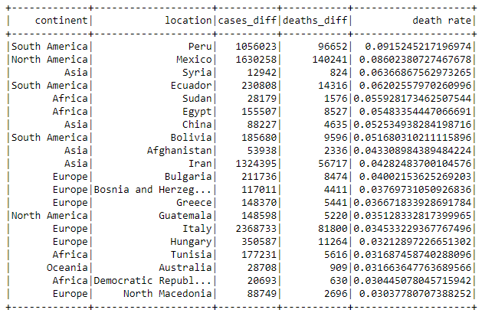
Death rate in one year

Slide 13
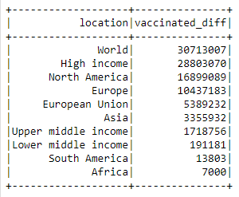
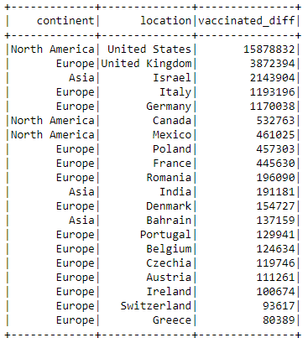
Number of vaccinated in one year

Slide 14
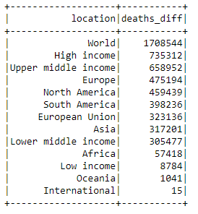
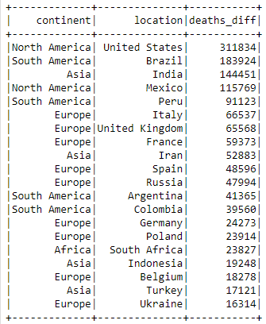
Number of deaths in one month (2021/12/16~2022/01/16)

Slide 15
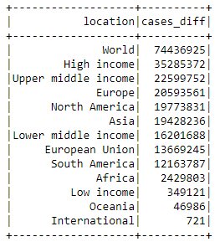
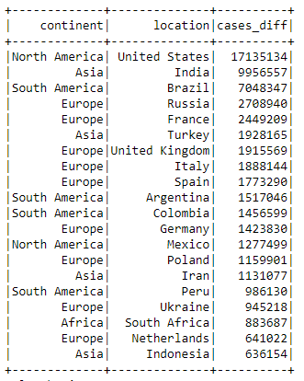
Number of cases in one month

Slide 16
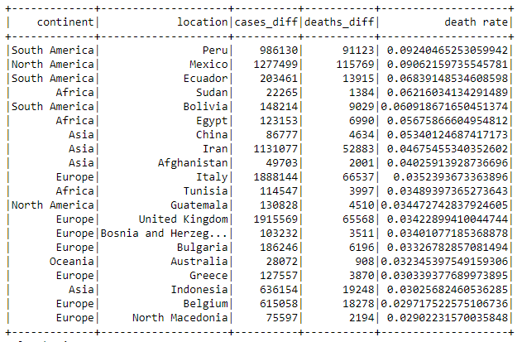
death rate in one month

Slide 17
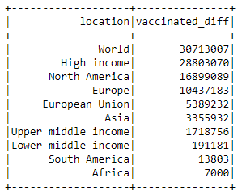
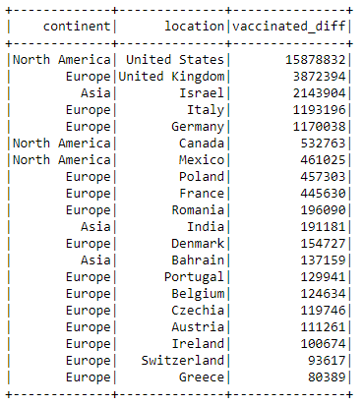
Number of vaccinated in one month

Slide 18
Conclusion
About Covid-19 data set, we show the number of these in one year:
deaths
cases
death rate
vaccinated
And we also show the same in the latest one month
You can see the situation of each country over the past year and a month

Slide 19
Reference
https://github.com/owid/covid-19-data/tree/master/public/data/
https://www.kaggle.com/techmon/covid19analysis-using-pyspark/data

Slide 20
END

